Slide 1

Java 4 WEB
Lesson 3 - OOP

Slide 2
Lesson goals
Class design
Implement encapsulation
Implement inheritance including visibility modifiers and composition
Implement polymorphism

Slide 3
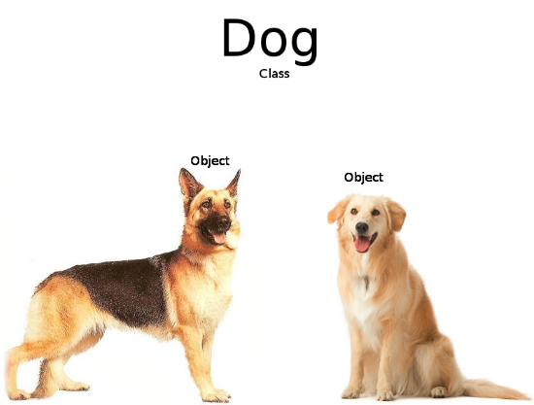
Object vs Class

Slide 4
Abstract Classes
May contain any number of methods including zero
If class has at least one abstract method – class is abstract
abstract void clean()
Abstract methods may not appear in a class that is not abstract
The first concrete subclass of an abstract class is required to implement all abstract methods that were not implemented by a superclass

Slide 5
Method vs Constructor
Method describes behavior
Method signature:
- name
- arguments (including order)
Specific method with the same to class name and without return statement called Constructor

Slide 6
Constructor
class Monkey extends Animal { int paws; public Monkey() { super(); // not necessary } Monkey(int paws) { super("Bandar-log");
paws = paws; // BAD this.paws = paws; } public void Monkey() { // this(3); // BAD } public void Monkey(int i) { System.out.println(“OMG”); }
}
class Animal { String name; Animal() { this("No-Name"); } public Animal(String name) { this.name = name; } }
class Main{ public static void main(String[] args) { println(new Monkey()); println(new Monkey(2)); } }

Slide 7
Overloading and Overriding
class Mario extends Game { @Override public void play() { // overriding // move to the left, move to the right } void play(Character character) { // overloading // omg, I’m chicken }
int play() { // will not compile // lol } }
class Game { void play() { // move to the left } }

Slide 8
Overriding rules
The access modifier must be the same or more accessible;
The return type must be the same or a more restrictive type, also known as covariant return types;
If any checked exceptions are thrown, only the same exceptions or subclasses of those exceptions are allowed to be thrown;
The methods must not be static. (If they are, the method is hidden and not overridden);
@Override - It is a great idea to get in the habit of using it in order to avoid accidentally overloading a method.

Slide 9
Overloading precedence
Exact match by type
Matching a superclass type
Converting to a larger primitive type
Converting to an autoboxed type
Varargs

Slide 10
Overloading precedence
class Overloading { static void overloadedMethod(int i) { // will enter if nothing is commented System.out.println("in int"); } static void overloadedMethod(long i) { // will enter if comment 'int' System.out.println("in long"); } static void overloadedMethod(Integer i) { // will enter if comment 'int' and 'long' System.out.println("in Integer"); } static void overloadedMethod(Number i) { // will enter if comment 'int', 'long' and 'Integer' System.out.println("in Number"); } static void overloadedMethod(int... i) { // will enter if comment 'int', 'long', 'Integer' and 'Number' System.out.println("in var arg"); } public static void main(String[] args) { overloadedMethod(10); } }

Slide 11
Interface
Defines a set of public abstract methods, which classes implementing the interface must provide.
Allows you to define what a class can do without saying how to do it (interface is a contract)
A class may implement multiple interfaces as well as extend classes that implement interfaces, allowing for limited multiple inheritance in Java
May extend other interfaces, although they may not extend a class and vice versa
May contain public static final constant values, public and private methods, public default methods.

Slide 12
Interface
interface Walk { int someConst = 1; public static final int anotherConst = 1; boolean isQuadruped();
private void doSomething() {
//do some work
} abstract double getMaxSpeed(); }
interface Run extends Walk { public abstract boolean canHuntWhileRunning(); default double getMaxSpeed(){ return 1; } }
class Lion implements Run { public boolean isQuadruped() { return true; } public boolean canHuntWhileRunning() { return true; } public double getMaxSpeed() { return 100; } }

Slide 13
Interface
Provides a way for one individual to develop code that uses another individual’s code, without having access to the other individual’s underlying implementation. Interfaces can facilitate rapid application development by enabling development teams to create applications in parallel, rather than being directly dependent on each other (for example one team uses interface, another team implements it)

Slide 14
Functional interface
@FunctionalInterface interface Speakable { String say(); static void someStatic(){} default void someDefault(){}
private void doSomething(){} }

Slide 15
Nested Classes
Types of nested classes:
A member inner class is a class defined at the same level as instance variables. It is not static. Often, this is just referred to as an inner class without explicitly saying the type.
A local inner class is defined within a method.
An anonymous inner class is a special case of a local inner class that does not have a name.
A static nested class is a static class that is defined at the same level as static variables.

Slide 16
Nested Classes
encapsulate helper classes by restricting them to the containing class
make it easy to create a class that will be used in only one place
can make the code easier to read.

Slide 17
Member Inner Classes
public static void main(String[] args) { A a = new A(); A.B b = a.new B(); A.B.C c = b.new C(); c.printAll(); }
class A { private int x = 1; class B { private int x = 2; class C { private int x = 3; public void printAll() { System.out.println(x); // 3 System.out.println(this.x); // 3 System.out.println(B.this.x); // 2 System.out.println(A.this.x); // 1 } } } }

Slide 18
Local Inner Classes
public static void main(String[] args) { Outer outer = new Outer(); outer.calculate(); }
class Outer { private int length = 5; public void calculate() { final int width = 20; class Inner { public void multiply() { System.out.println(length * width); } } Inner inner = new Inner(); inner.multiply(); } }

Slide 19
Anonymous Inner Classes
public static void main(String[] args) throws Exception { JButton button = new JButton("red"); button.addActionListener(new ActionListener() { public void actionPerformed(ActionEvent e) { // handle the button click } }); }

Slide 20
Static Nested Classes
class Enclosing { static class Nested { private int price = 6; } public static void main(String[] args) { Nested nested = new Nested(); System.out.println(nested.price); } }

Slide 21
Enum
A special data type that enables for a variable to be a set of predefined constants
Has unique set of values
Can implement interface
Can NOT extend class
Can contain fields and methods
Singleton

Slide 22
Enum
enum Planet implements IGravitable { MERCURY (3.303e+23, 2.4397e6) { @Override double surfaceGravity() { return -1; } }, VENUS (4.869e+24, 6.0518e6), EARTH (5.976e+24, 6.37814e6) // ... ; private double mass; // in kilograms final double radius; // in meters
Planet(double mass, double radius) {// private this.mass = mass; this.radius = radius; }
// universal gravitational constant (m3 kg-1 s-2) public static final double G = 6.67300E-11;
@Override double surfaceGravity() { return G * mass / (radius * radius); } }
static void main(String[] args) { double mass = Planet.EARTH.surfaceGravity();
for (Planet p : Planet.values()){ System.out.println("Your weight on %s is %f%n", p,
p.surfaceWeight(mass)); } System.out.println("Is Earth inhabited: " +
isPlanetInhabited(Planet.EARTH));; } static boolean isPlanetInhabited(Planet alivePlanet) { switch (alivePlanet){ case EARTH: return true; case VENUS: case MERCURY: default: return false; } }

Slide 23
Design principle
A design principle is an established idea or best practice that facilitates the software design process.

Slide 24
Design principle
More logical code
Code that is easier to understand
Classes that are easier to reuse in other relationships and applications
Code that is easier to maintain and that adapts more readily to changes in the application requirements

Slide 25
OOP principles
Class
Object
Inheritance
Encapsulation
Polymorphism

Slide 26
OOP principles
Everything is object
Object is a class instance
Program – a set of interacting objects
Object has a state and behavior

Slide 27
Access modifiers
public class Dog { public String name = "Scooby-doo"; protected boolean hasFur = true; boolean hasPaws = true; private int id; }

Slide 28
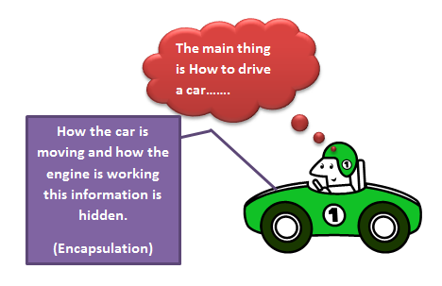
Encapsulation

Slide 29
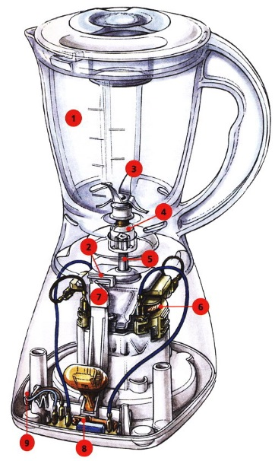
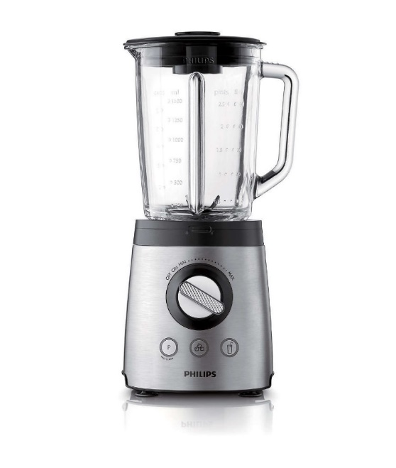
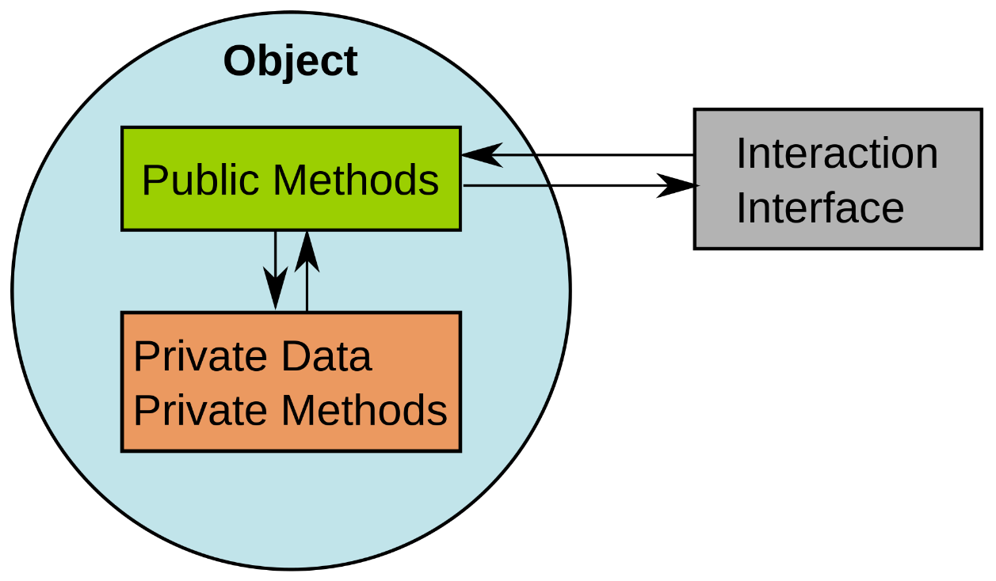
Encapsulation

Slide 30
Encapsulation
No actor other than the class itself should have direct access to its data. The class is said to encapsulate the data it contains and prevent anyone from directly accessing it. With encapsulation, a class is able to maintain certain invariants about its internal data. An invariant is a property or truth that is maintained even after the data is modified.

Slide 31
Encasulation example
class CoffeeMachine {
private int sugar;
private double milk;
Coffee makeCoffee(){ blendBeans(); heatWater(); shakeMilk(); return mix(); } private Coffee mix() { return new Coffee(); // mix all together } private void shakeMilk() { // shaking milk } private void heatWater() { // heating water } private void blendBeans() { // blending beans } }
public static void main(String[] args) { CoffeeMachine cm = new CoffeeMachine(); Coffee coffee = cm.makeCoffee(); }

Slide 32
Encapsulation. Java Beans
A JavaBean is a design principle for encapsulating data in an object in Java.
private properties
public getter(get, is for primitive boolean)
public setter (set)
property name in getter/setter starts with uppercase

Slide 33
Encapsulation. Java Beans
public boolean isPlaying() { return playing; } public boolean getPlaying() { return playing; } public Boolean isDancing() { return dancing; } public String name() { return name; } public void updateName(String n) { name = n; } public void setname(String n) { name = n; }
What is wrong
class Girl { private boolean playing; private Boolean dancing; public String name;
… }

Slide 34
Encapsulation. Java Beans
public boolean isPlaying() { // OK return playing; } public boolean getPlaying() { // OK return playing; } public Boolean isDancing() { // BAD, get for wrapper return dancing; } public String name() { // BAD, not get prefix return name; } public void updateName(String n) { // BAD, no set prefix name = n; } public void setname(String n) {// BAD, wrong case name = n; }
What is wrong
class Girl { private boolean playing; private Boolean dancing; public String name;
… }

Slide 35
Polymorphism
An object in Java may take on a variety of forms, in part depending on the reference used to access the object.
One name, many forms. Polymorphism manifests itself by having multiple methods all with the same name, but slightly different functionality.
There are 2 basic types of polymorphism.
Overriding, also called run-time (dynamic) polymorphism.
Overloading, which is referred to as compile-time (static) polymorphism.

Slide 36
Polymorphism
The type of the object determines which properties exist within the object in memory.
The type of the reference to the object determines which methods and variables are accessible to the Java program

Slide 37
Polymorphism
Polymorphism is the ability of a single interface to support multiple underlying forms.
interface LivesInOcean { void makeSound(); } class Dolphin implements LivesInOcean { public void makeSound() { System.out.println("whistle"); } } class Whale implements LivesInOcean { public void makeSound() { System.out.println("sing"); } }
class Oceanographer { void checkSound(LivesInOcean animal) { animal.makeSound(); } void main(String[] args) { Oceanographer o = new Oceanographer(); o.checkSound(new Dolphin()); o.checkSound(new Whale()); } }

Slide 38
Polymorphism
Polymorphism also allows one object to take on many different forms.
class Primate { public boolean hasHair() { return true; } } interface HasTail { boolean isTailStriped(); }
class Lemur extends Primate implements HasTail { public int age = 10; public boolean isTailStriped() { return false; }
}
public static void main(String[] args) { Lemur lemur = new Lemur(); println(lemur.age);
HasTail hasTail = lemur; println(hasTail.isTailStriped());
Primate primate = lemur; println(primate.hasHair()); }

Slide 39
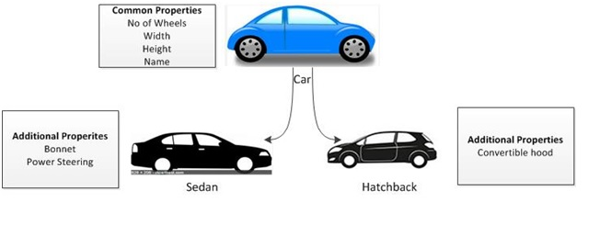
Inheritance (is-a)

Slide 40
Inheritance (is-a)
class Cow extends Animal { @Override public void feed() { } public void run(){ } }
class Bird extends Animal { @Override public void feed() { } public void fly(){ } }
abstract class Animal { String name; @Override public String toString() { return name; } abstract void feed(); }

Slide 41
Virtual methods invocation
class Cow extends Animal { public void feed() { addHay(); } private void addHay() { } } class Bird extends Animal { public void feed() { addSeed(); } private void addSeed() { } } class Lion extends Animal { public void feed() { addMeat(); } private void addMeat() { } }
abstract class Animal { public abstract void feed(); }
public void feedAnimal(Animal animal) { animal.feed(); }

Slide 42
Composition (has-a)
Object composition is the idea of creating a class by connecting other classes as members using the has‐a principle.
Inheritance is the idea of creating a class that inherits all of its reusable methods and objects from a parent class.
Both are used to create complex data models, each with its own advantages and disadvantages

Slide 43
Composition (has-a)
class Person { Job job; public Person() { this.job = new Job(); job.setSalary(1000L); } public long getSalary() { return job.getSalary(); } }
class Job { private long salary; public void setSalary(long salary) { this.salary = salary; } public long getSalary() { return salary; } }

Slide 44
Literature
https://docs.oracle.com/javase/tutorial/java/javaOO/index.html
https://docs.oracle.com/javase/tutorial/java/IandI/index.html
https://docs.oracle.com/javase/tutorial/java/concepts/index.html

Slide 45
Homework
Implement classes: SUV, Sedan, Hatchback3Doors, Hatchback5Doors
SUV, Sedan, Hatchback3Doors, Hatchback5Doors should extend Vehicle
Vehicle provides info: name, max passengers number, number of doors
Vehicle should implement Drivable
Each Vehicle contains Accelerator, BrakePedal, Engine, GasTank, SteeringWheel
Implement Accelerator, BrakePedal, Engine, GasTank, SteeringWheel according to their names:
Accelerator works 5 seconds (5 times) and speed-up the car for a some accelerateStrength
BrakePedal slow down the car for a some brakingStrength
Engine hat it capacity, max speed, can be started or stopped, uses fuel from GasTank when work
GasTank has it max and current volumes, GasTank can use fuel or can be filled by it
SteeringWheel has it max turn angle, current turn angle and step (one turn changes the current angle for this value), SteeringWheel can be turned left or right
Verify all properties of each car part they cannot be greater than some max value and less than some min value (see tests); speed, volume cannot be negative or greater than max speed and/or volume
Engine, GasTank, SteeringWheel should implement interface StatusAware
Create class ControlPanel that must control the Drivable regardless of what type of vehicle it is transmitted

Slide 46
